Slide 1
HDP October Status Update
Copper Balancing Part 2

Slide 2
Total Copper Visualization
Pixel Size
User defined
Pixel count set small enough to capture traces and anti-pads
Analysis time decreases as pixel count increases
Color Thresholds for Visualization
Set “white” to a reference band
(i.e. Design Average +/-10%)
Red Hues above reference band
Blue Hues below reference band

Slide 3
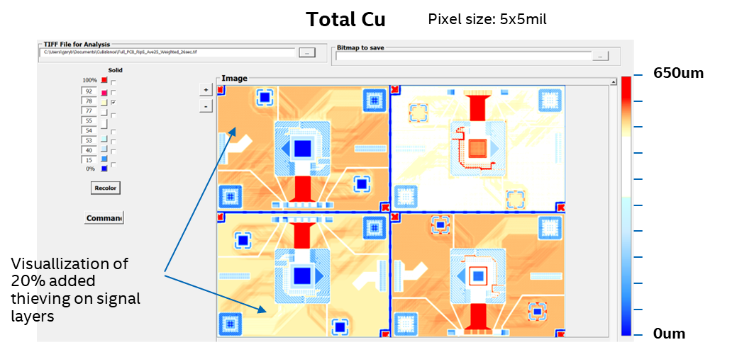
Initial Board Design
Q3 == Q2 with smaller voids and added Cu under components
Q2 == Q1 with 20% thieving on 6 signal layers (4.6% added cu)
Q2
Q4
Q1
Q3

Slide 4
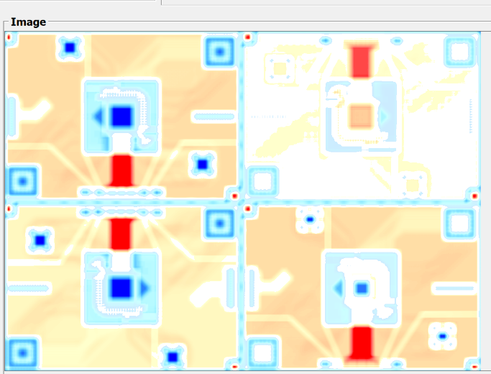
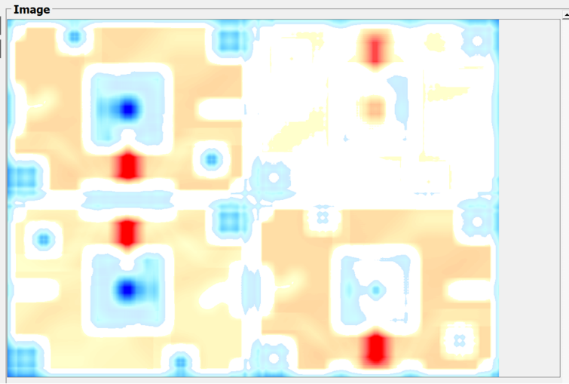
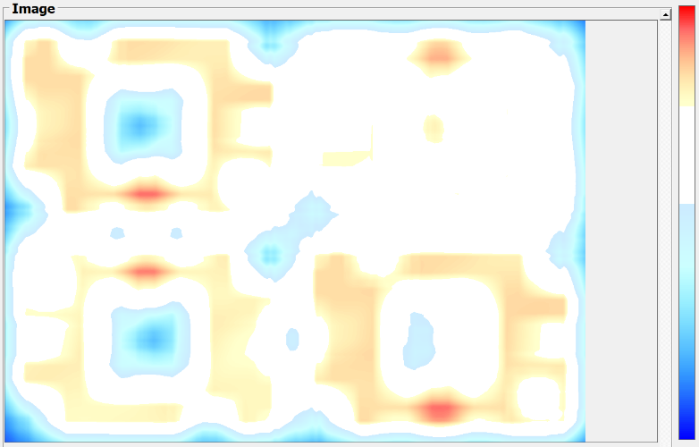
Rolling average washes out high/low as expected
Captures general shape and symmetry patterns of large low copper areas - tracks with Phase 1 findings
Minimizes impact of small and large areas of stacked copper areas. The stand-off or glass stop conditions need to be captured.
0.5inch
1.25inch
Asymmetry of average thickness
2.5inch

Slide 5


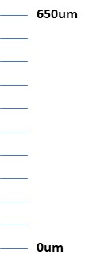
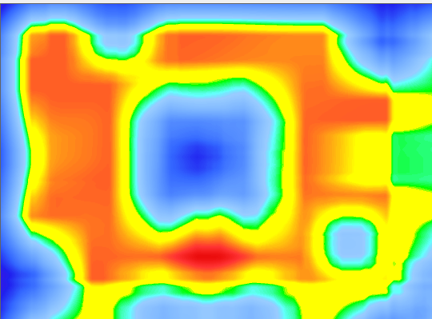

Color Thresholds
Changing color threshold mute or accnture patterns and gradient detail
White bands good for mapping areas to address with design
Full bands appear to have better visual correlation with Shado-Moire measurements
650um
0um

Slide 6
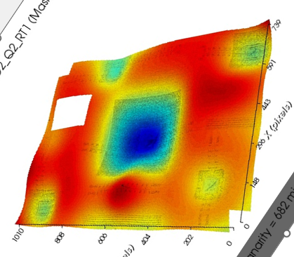
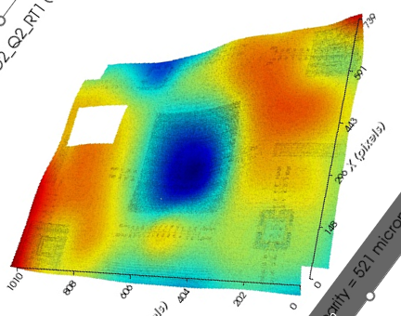
Averaging vs Phase 1 Measurements
So far, the 1.5-2.5” radius averaging correlates well to many of the panels with high measured co-planarity
Next step is to look at refining algorithms to evaluate >2.5” averaging radius
Panel 2, Mtrl A
Panel 1, Mtrl B
650um
0um
Coplanarity of Q2 Shadow Moire
Total Cu map Q2 with rolling average of 2.5”

Slide 7
Current Progress
Converted from VBA to Python to expand functionality
3 separate algorithms for blending
Gauss
MetAve
Step
Method to convert gerber to tiff to 2d array without MetAve or ‘Artwork’ software
Added preset color thresholds for analysis
Modified User Interface for more functionality

Slide 8
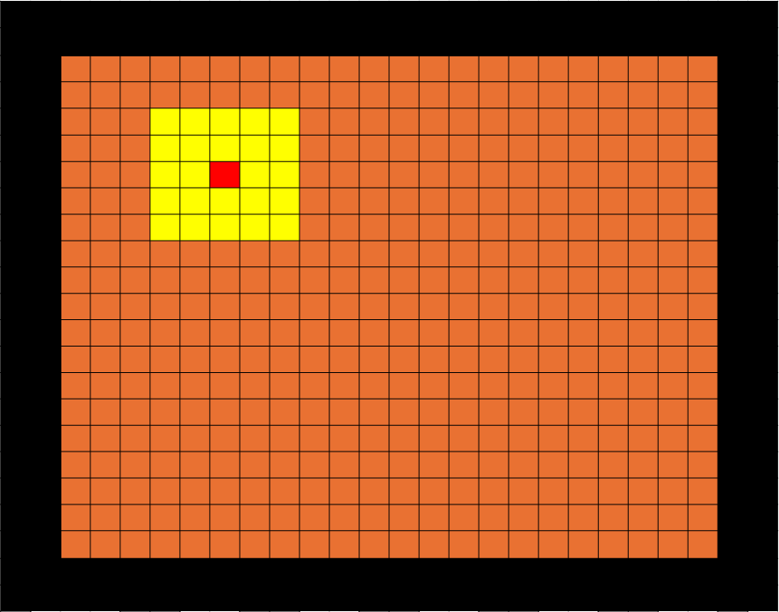
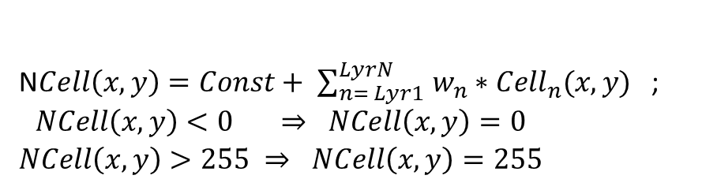
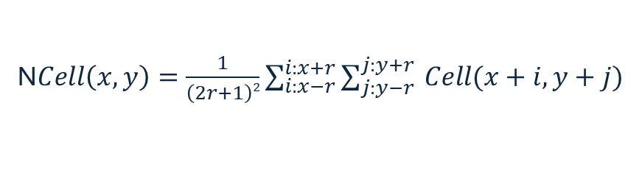
MetAve Algorithm
Command line executable
Inputs
Input Layers
Layer Weighting
Averaging window
Weighted Result
Rolling average of target
N$Cell\left(x,y\right)=Const+ \sum_{n= Lyr1 }^{LyrN}{w_{n}∗{Cell}_{n}(x,y)}$ ;
$$\begin{matrix}NCell\left(x,y\right)<0 ⇒ NCell\left(x,y\right)=0 \\ NCell\left(x,y\right)>255 ⇒ NCell\left(x,y\right)=255\end{matrix}$$
Ncell(x, y)
N$Cell\left(x,y\right)=\frac{1}{\left(2r+1\right)2}\sum_{i:x−r}^{i:x+r}{\sum_{j:y−r }^{j:y+r}{Cell(x+i,y+j)}}$
r = 2

Slide 9
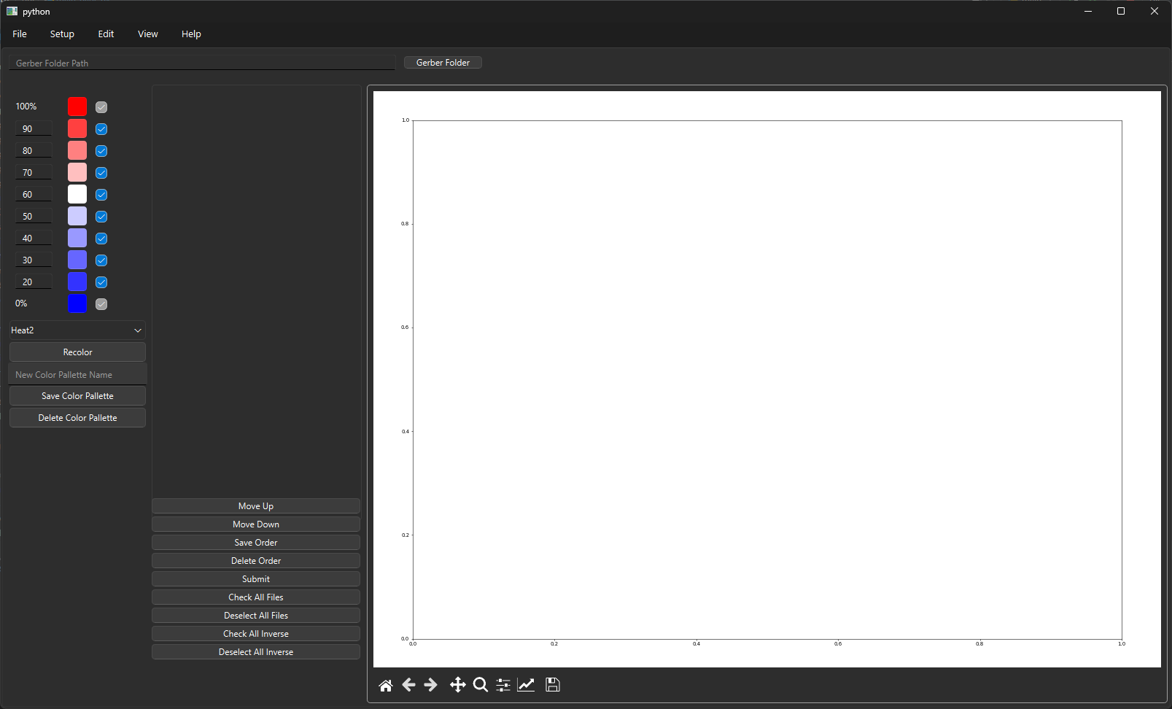

Slide 10
Future Work

Slide 12
